Slide 1
Information System Development
Information System Management
Course No: 0612-301

Slide 2
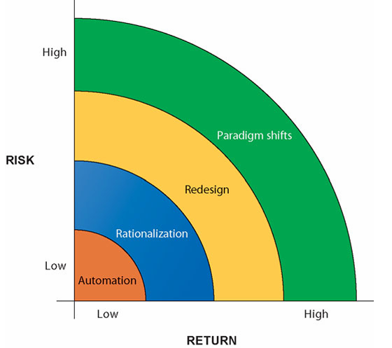
Information System Development
Building a new information system is one kind of planned organizational change.
Information technology can promote various degrees of organizational change –
Automation
Rationalization
Redesign
Paradigm shift

Slide 3
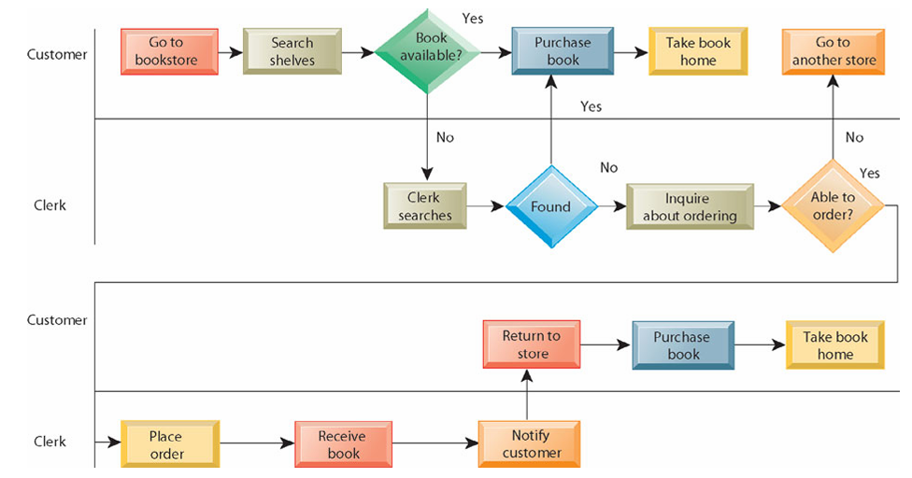
Information System Development
Before redesigning book-purchase process from a bookstore –

Slide 4
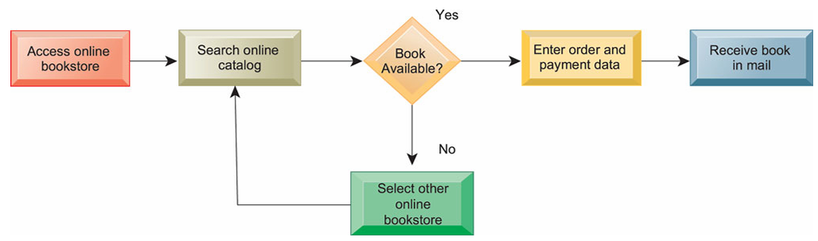
Information System Development
After redesigning book-purchase process by applying IT –

Slide 5
Information System Development
Successfully developed system may result in –
Improve efficiency and operational performance.
Optimized workflows.
Lower headcount i.e. reduced number of workers.
Fewer disputes, costs, and errors.
Accurate financial information.
High return on investment.

Slide 6
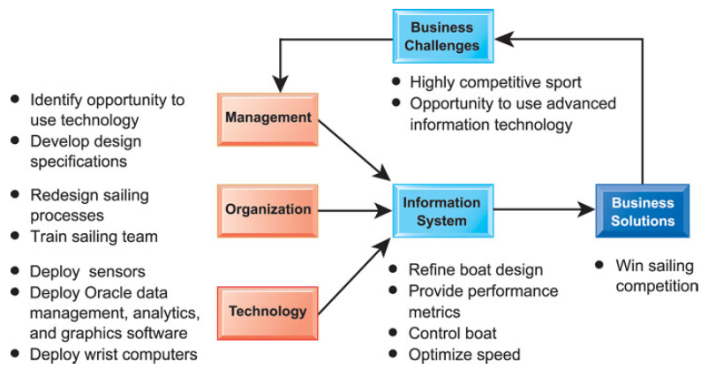

Information System Development
The BMW Oracle Racing organization won the 33rd America’s Cup yacht in 2010.
The BMW Oracle boat USA, backed by software billionaire Larry Ellison, beat Alinghi, the Swiss boat backed by Ernesto Bertarelli, a Swiss billionaire.

Slide 7
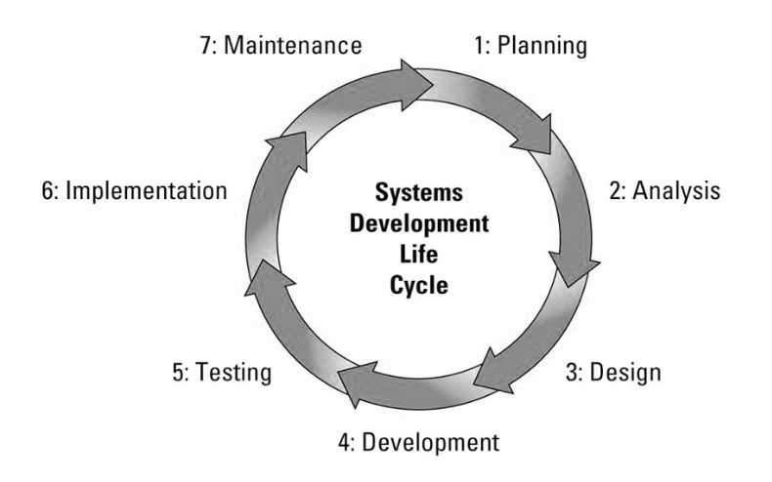
System Development Life Cycle (SDLC)
System Development Life Cycle (SDLC) has 7 steps –
Planning
Analysis
Design
Development
Testing
Implementation
Maintenance

Slide 8
SDLC
SDLC can mean various things –
System Development Life Cycle
Can be applied to any system.
Software Development Life Cycle
Focuses on software systems.
System Design Life Cycle
Focuses on the phase where the designing of the architecture, components, and interactions of the system takes place.

Slide 9
Planning
Identify the system objectives, recognize the needs.
Define the problems and scope.
Set timeline and schedule.
Allocate necessary resources.
Perform feasibility study i.e. preliminary analysis.
Consider threats, constraints, integration, and security of the system.

Slide 10
Planning
Feasibility Study –
Also called Preliminary Analysis/Preliminary Survey/Preliminary Investigation.
Evaluation of the existing system and analysis of the alternative candidates.
What are the user’s demonstration needs?
Is the problem worth solving?
How can the problem be redefined?
Technical feasibility, behavioral feasibility, cost/benefit analysis, etc.
Presented as a report.
Some considers it in planning phase, others put it in analysis phase.

Slide 11
Analysis
Gather, analyze, and validate the information.
Perform observations, interview, questionnaires, etc. with the end-users.
Perform detailed analysis.
Determine each stakeholders (user, customer, etc.) needs and perspectives.
Identify pros and cons, recommend solution.
Prepare a software requirement specification (SRS) document.
Produce the logical model of the system.

Slide 12
Design, Development
Design
Translate the gathered requirements into a detailed technical blueprint.
Design system architecture, database models, user interfaces, network, etc.
System elements such as input, output, and processing are designed.
Business rules, process diagrams, pseudocodes, etc. are detailed.
Prototype models are also produced.
Development
According to the design, the coding i.e. the development takes place at this phase.

Slide 13
Testing
Unit testing –
Testing an individual module or component in isolation.
UI testing –
Testing whether the graphical user interface is working properly or not.
Integration testing –
Testing how the parts of a system or subsystem work together.
Big-bang testing - take the entire integrated system and test it all at once.
Incremental testing –
First test each individual subsystem in isolation, and then continue testing while integrating more and more subsystems.
Can be horizontal or vertical.
For horizontal testing, simply test each sub-system in isolation.
Vertical testing can be top-down, bottom-up, or sandwich.

Slide 14
Testing
Black box testing –
The testers provide the system with inputs and observe the outputs.
They cannot see what is going on inside, the source code, the internal data, or the design documentation describing the system’s internals.
Glass box testing –
Also known as White box testing.
The tester can examine the design documents, the code, steps taken by algorithms during run time, and their internal data.
More time consuming than black box testing but also, more thorough.

Slide 15
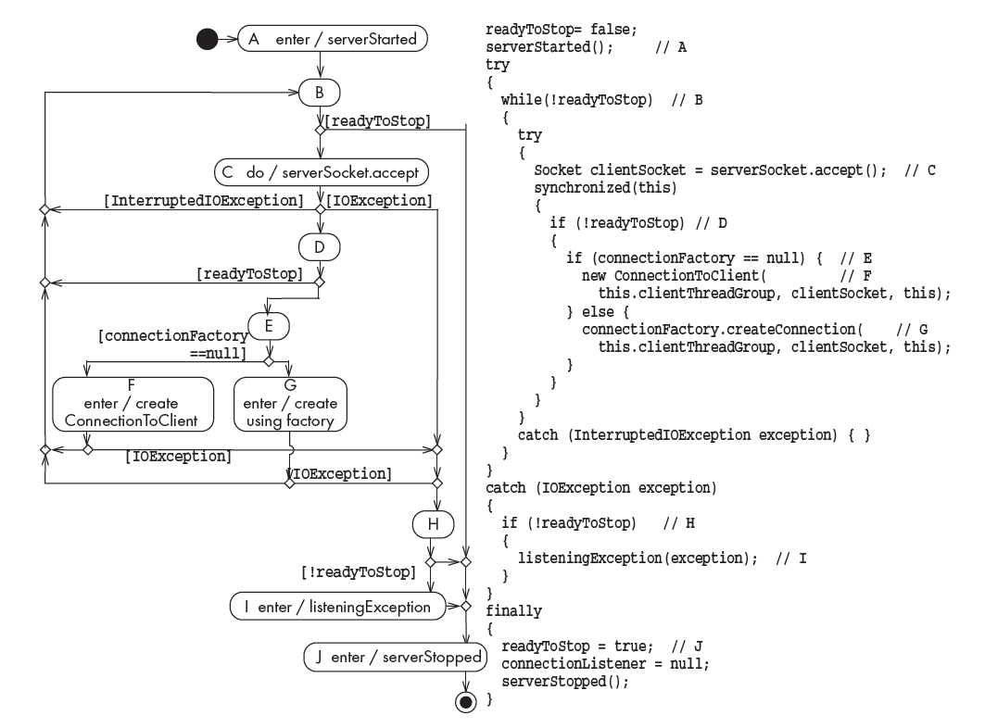
Testing
From the flow graph of the system, these matters are ensured in glass-box testing –
Covering all possible paths
Covering all possible edges
Covering all nodes

Slide 16
Testing
Regression testing –
Give each failure a priority based on their criticality.
High priority bugs are fixed.
But, fixing bugs will cause new bugs. It is called ripple effect.
Do an impact analysis to find out all the possible effects of a change.
After making the change, run a subset of original test cases – regression testing.
Avoid running all the test cases, because that’s expensive.
Instead, cover as much as possible by regression testing.
ensure that the core features continue to work after any new changes or updates in the system.
Smoke testing –
determine if a new software build is ready for the next testing phase
smoke testing finds basic and critical issues in an application before more in-depth testing is done
Incompatibilities and show-stopper errors are found early.

Slide 17
Testing
Alpha testing –
Performed by users and clients, under the supervision of the software dev team.
Beta testing –
Performed by users and clients, in normal work environment, on a pre-release version.
User acceptance testing –
Users and customers do it on their own initiative.
Recovery testing
Security testing
Stress testing
Performance testing
Deployment testing

Slide 18
Implementation, Maintenance
Implementation
Deploy the system into live environment.
System installation, migrating data, and configuring infrastructure.
Training operational staffs and end-users.
Maintenance
Monitor, maintain, and update the system as needed.
Includes bug fixes, performance enhancements, security patches, etc.
User feedback is taken.

Slide 19
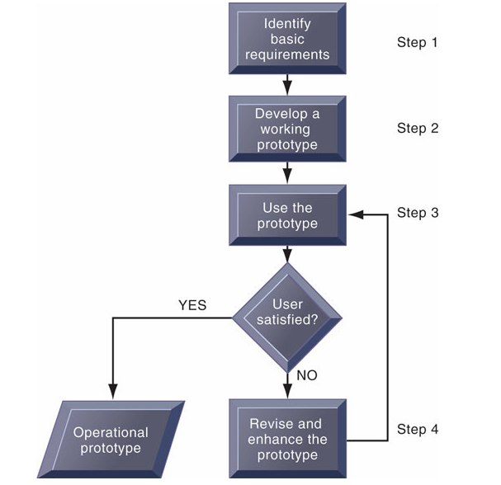
Prototyping
A working version of an information system or part of the system, but it is meant to be only a preliminary model.
Once operational, the prototype will be further refined until it conforms precisely to users’ requirements.
Prototyping is more explicitly iterative than the conventional life cycle.

Slide 20
Software Development Models
Opportunistic Approach
Big Bang Model
Waterfall SDLC Model
Phased-released Model
Spiral SDLC Model
Concurrent Engineering Model
Iterative Incremental Model
Evolutionary Model
Rapid Action Development (RAD) Model
V-Shaped Model
Agile Model
Dev Ops Model

Slide 21
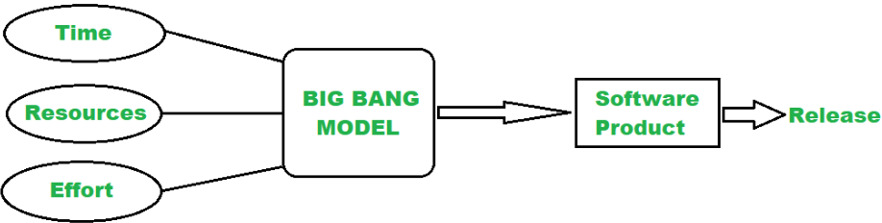
Software Development Models
The Opportunistic Approach
The Big Bang Model

Slide 22
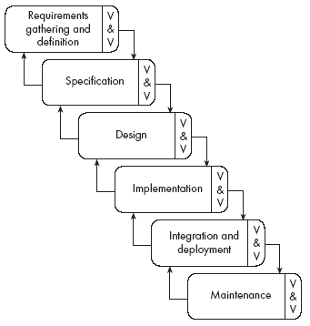
The Waterfall SDLC Model
Sequential Approach –
Each phase of the project is completed before moving on to the next one.
Document-driven –
Depends on documentation to ensure that the project is well-defined and the project team is working towards a clear set of goals.
Quality Control –
Places a high emphasis on quality control and testing at each phase of the project.
V & V - Verification and Validation.
Rigorous Planning –
Project scope, timelines, and deliverables are carefully defined and monitored.

Slide 23
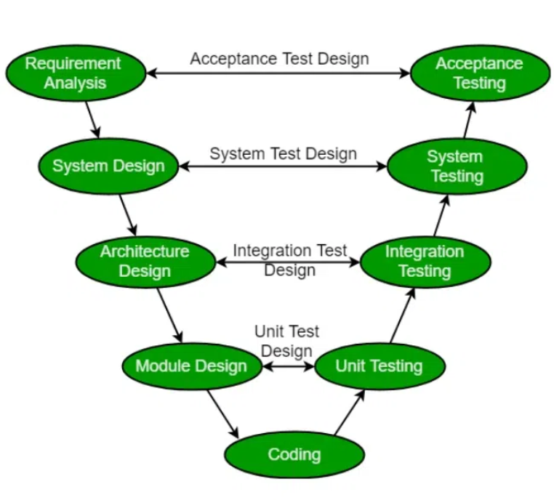
The V-shaped Model
Also known as the Verification and Validation model.
There are Verification phases on one side of the ‘V’ and Validation phases on the other side.
The Coding Phase joins the two sides of the V-Model.
Verification phases focus planning and designing the system.
Validation phases focus on testing and validation against the specifications.

Slide 24
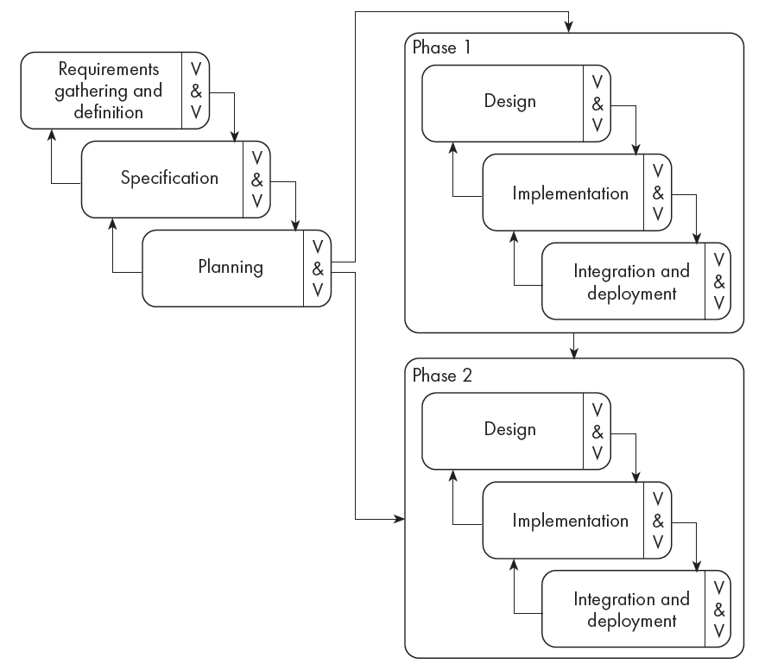
The Phased-Release Model
Rectifies some, but not all, of the problems of the waterfall model.
Introduces the notion of incremental development.
After requirements gathering and planning, the project should be broken into separate subprojects, or phases.
Each phase can then be released to customers when ready.

Slide 25
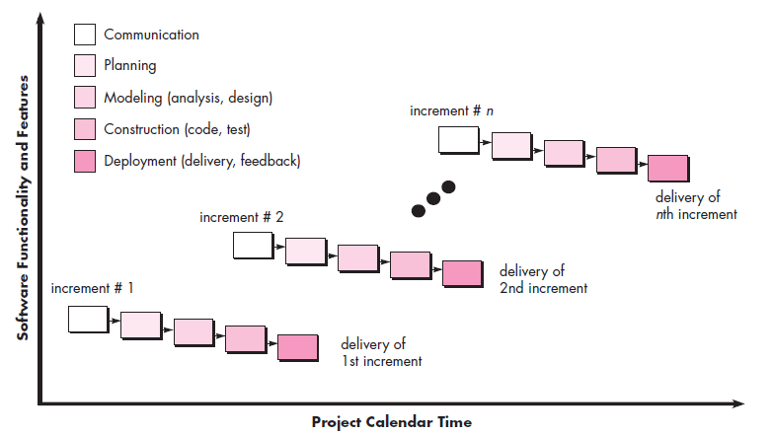
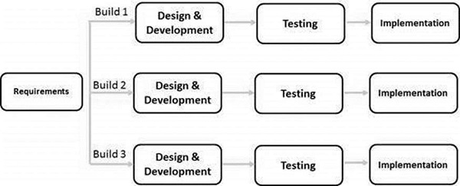
The Iterative Incremental Model
The basic idea behind this method is to develop a system through repeated cycles (iterative) and in smaller portions at a time (incremental).
Starts with a simple implementation of a small set of the software requirements and iteratively enhances the evolving versions.

Slide 26
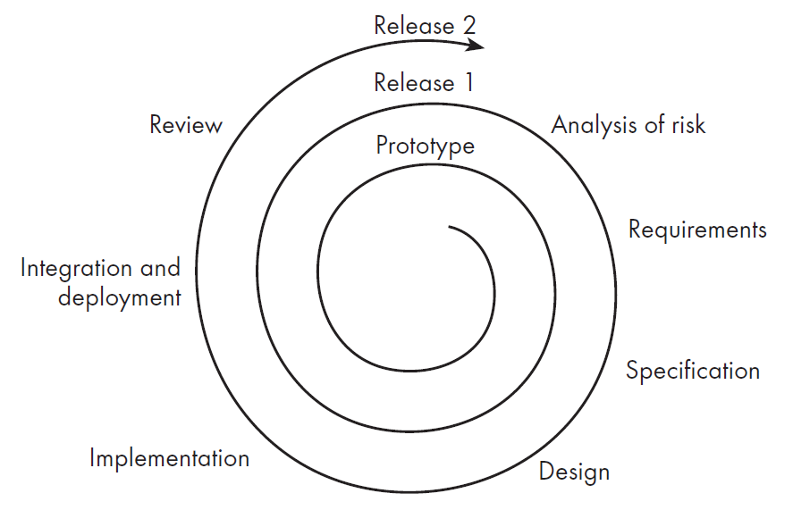
Spiral Model
Start the development by quickly developing a small prototype.
There may be several cycle of prototyping.
Adds the notion of risk analysis to process modeling.
Implies that the maintenance is simply a type of ongoing development.
It is also called a Meta model because it incorporates waterfall model, prototyping model, and evolutionary model.

Slide 27
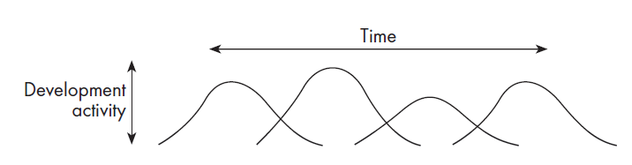
Evolutionary Model
Shows software development as a series of hills, each representing a separate loop of the spiral.
Loops, or releases, tend to overlap each other.
As testing and preparations for deployment of one release are under way, planning for the next release has already started.
development work tends to reach a peak, at around the time of the deadline for completion of implementation.
Each prototype or release can take different amounts of time to deliver, and can take differing amounts of effort.

Slide 28
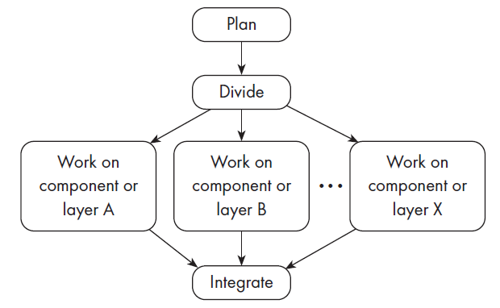
The Concurrent Engineering Model
Explicitly accounts for the divide and conquer principle.
Each team works on its own component, typically following a spiral or evolutionary approach.
There has to be some initial planning, and periodic integration

Slide 29
The Rapid Action Development (RAD) Model
Focuses on delivering working software in a short timelines.
Emphasizes quick and iterative release cycles.
More flexible and responsive to user feedback and changing requirement.
The RAD model is used when the requirements are fully understood and the component-based construction approach is adopted.
Close teamwork among end users and information systems specialists.
Applies reusable softwares and frameworks.
Agile development is a type of RAD model.
Breaks the large project into a series of subproject and build them in short periods using iteration and continuous feedback.
Emphasizes face-to-face communication over written documents.

Slide 30
Structured Methodologies
Structured refers to the fact that the techniques are step by step, with each step building on the previous one.
Structured methodologies are top-down, progressing from the highest, most abstract level to the lowest level of detail—from the general to the specific.
Structured analysis, modeling, and design methods are process-oriented.
These methods separate data from processes.
These processes (or actions) capture, store, manipulate, and distribute data as the data flow through a system.
Some structured languages are – C, Pascal, Fortran, COBOL, BASIC, etc.

Slide 31
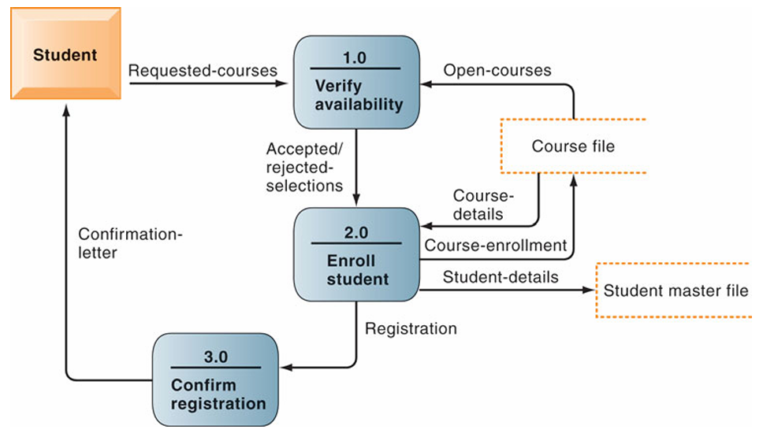
Structured Methodologies
Data Flow Diagram (DFD):
A tool to represent a system’s component processes and the flow of data between them for structured analysis.
Offers a logical graphic model of information flow.
Partitions a system into modules that show manageable levels of detail.
Can be used to depict both higher-level processes and lower level details.

Slide 32
Object Oriented Approach
Object oriented paradigm –
Organizing procedural abstractions in the context of data abstractions.
All computations are performed in the context of objects.
Objects contain data and methods.
A running program can be seen as a collection of objects collaborating to perform a given task.

Slide 33
Object Oriented Approach
Class –
A unit of abstraction in an object oriented program.
Represents similar objects and instances.
A kind of software module that represents the instances’ structure and behavior.
Variables defines inside class are called fields or member variables.
Member variables can be instance variables and class variables.
Object and Instances –
A chunk of structured data in a running software system.
A concrete realization of a class, containing data and methods.
Has properties (data) and behavior (functions).
Instance refers to a particular object created from a class.

Slide 34
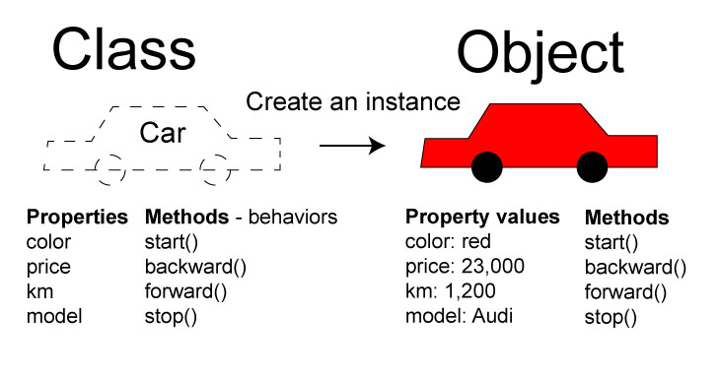
Object Oriented Approach

Slide 35
Object Oriented Approach
Four pillars of object oriented programming –
Encapsulation –
The process of wrapping code and data together into a single unit.
Access modifiers (e.g. private, public, protected, default) are used to set the visibility level and have more control on the properties.
Inheritance –
The process of one class inheriting properties and methods from another class.
Can be single, multiple, multilevel, hierarchical, and hybrid.
Enables reusability.
Polymorphism –
The ability to perform many things in many ways.
Can be static (compile-time) and dynamic (runtime).
Abstraction –
Hiding implementation details and exposing only the functionality to the user.
Abstract classes (Interface in java) provide only the functions, not the implementations.

Slide 36
Object Oriented Approach
If a class ‘Car’ is inherited from another class ‘Transport’, then-
‘Transport’ is base class/parent class/superclass.
‘Car’ is derived class/child class/sub class.
Generalization –
Bottom-up approach.
The process of extracting common features from subclasses and makes a generalized superclass.
In the example, ‘Transport’ is a generalized class.
Specification –
Top-down approach.
The process of creating more specific subclasses from a general superclass by adding more attributes or behaviors.
In the example, ‘Car’ is a specific class.

Slide 37
Object Oriented Approach
The IS-A rule represents an inheritance relationship, where a subclass is a specialized version of its superclass.
A ‘Car’ is a ‘Transport’.
A ‘Circle’ is an ‘Ellipse’.
The inheritance hierarchy shows the relationship between the super classes and the subclasses.
A triangle means generalization.

Slide 38
Object Oriented Approach
Abstract class –
A class that cannot be instantiated and is meant to be extended.
Provides a base class with common properties and behaviors for subclasses.
Can contain abstract methods and concrete methods.
Can have constructors, fields, and static methods.
A subclass must override all abstract methods or declare itself abstract.
Cannot create objects of an abstract class directly.
Supports multiple levels of inheritance.
Abstract method –
A method without a body.
Must be implemented by the subclasses.

Slide 39
Object Oriented Approach
Method overriding –
When a subclass provides a specific implementation of a method that is already defined in its superclass.
The method in the subclass must have the same name, return type, and parameters as in the superclass.
Overriding can only occur when a subclass inherits from a superclass.
Cannot reduce the visibility, but can increase it.
Constructors, static, and final methods can not be overridden.
Enhances Code Flexibility and Reusability.

Slide 40
Object Oriented Approach
Compile time polymorphism –
Method binding happens at compile-time.
Achieved through method overloading and operator overloading
Resolved by the compiler before execution.
Less flexible but faster.
Can work within the same class.
Run time polymorphism –
Method binding happens at runtime.
Achieved through method overriding and upcasting.
Resolved during runtime based on the actual object.
More flexible but slightly slower.
Requires inheritance and method overriding.

Slide 41
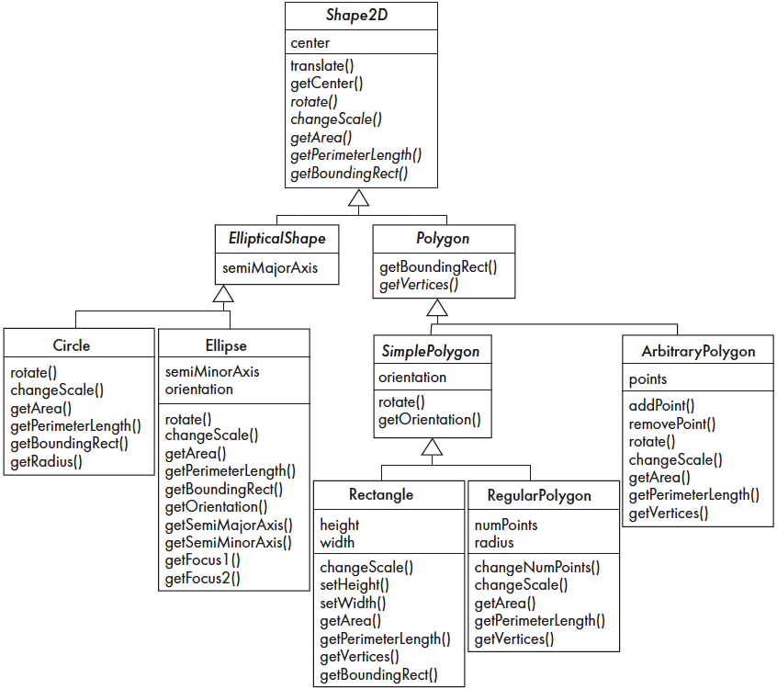
Inheritance and Polymorphism

Slide 42
Object Oriented Approach
Casting –
The process of converting one data type into another.
Implicit – Done by the compiler.
Explicit – Done be the programmer.
Primitive type casting –
Widening –
Smaller to large data types.
Ex: int var1 = 10; long var2 = (long) var1;
Narrowing –
Larger to smaller data types.
Ex: long var1 = 10; int var2 = (int) var1;
Reference type casting –
Upcasting –
Converting a subclass to a superclass.
Ex: Superclass obj = new Subclass();
Downcasting –
Converting a superclass to a subclass.
Ex: Superclass obj1; Subclass obj2 = (subclass) obj1;

Slide 43
Object Oriented Approach
Interfaces –
A feature in java.
Only abstract, default, and static methods are allowed.
Cannot have instance variables and constructors.
A class can implement multiple interfaces.
Ex:
interface Animal { void makeSound(); }
class Dog implements Animal {
public void makeSound() { System.out.println("Dog barks"); }
}
public class Main {
public static void main(String[] args) {
Animal myDog = new Dog(); myDog.makeSound();
// Output: Dog barks
}
}

Slide 44
Object Oriented Approach
Access specifiers –
Private
Only the methods of the current class can access.
Protected
Inherited classes can also access these variables.
Default
Classes within the same package can access.
Not in C++.
Public
Anybody can access.

Slide 45
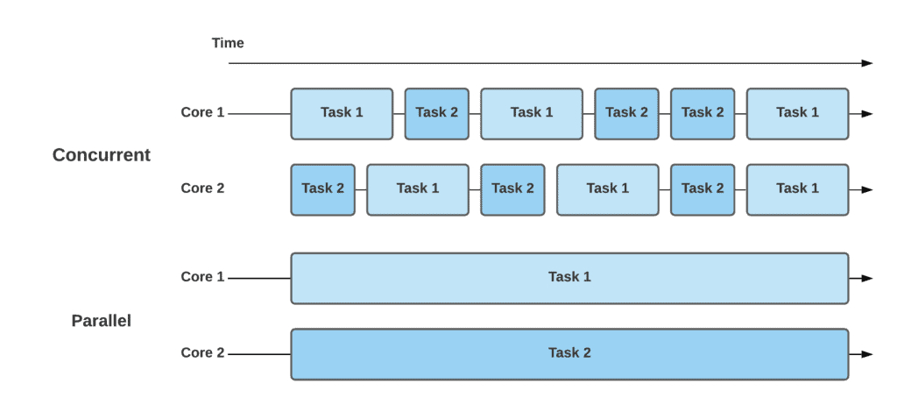
Object Oriented Approach
Threads –
a single path of execution in a program.
Each thread can run a specific task.
Multithreading –
Running multiple tasks simultaneously in the same program.
A program can have multiple threads (e.g., handling user input, data processing, and UI updates at once).
Concurrency means allowing multiple tasks to progress simultaneously.
Parallelism means performing multiple tasks simultaneously.

Slide 46
Object Oriented Approach
Programming style guidelines –
Codes should be easy-to-understand, readable, portable and maintainable.
Reject clever code that is hard to understand.
Shorter code is not necessarily better.
Choose good and highly descriptive names.
Comment extensively. Comments should be about 25-50% of the code.
Do not comment the obvious.
Be consistent with organizing class elements and code layout.
Adhere to OOP principles and standard tech-stack-specific practices.
Avoid code duplication.
Prefer private as opposed to public.
Do not mix user interface code with non-user interface code.
Consider language evolution and depreciated features.
Be efficient in choosing languages and features.

Slide 47
References
System Analysis and Design – Elias M. Awad
Chapter 2
Software Engineering – Roger S. Pressman
Chapter 2, 17
Object-Oriented Software Engineering – Timothy C. Leithbridge, Robert Lagniere
Chapter 10
Management Information System – Kenneth C. Laudon, Jane P. Laudon
Chapter 2, 13
https://www.geeksforgeeks.org/system-development-life-cycle/
https://www.tutorialspoint.com/system_analysis_and_design/system_analysis_and_design_development_life_cycle.htm
https://en.wikipedia.org/wiki/Systems_development_life_cycle
https://www.tutorialspoint.com/sdlc/sdlc_software_prototyping.htm
https://www.geeksforgeeks.org/software-development-life-cycle-sdlc/
Internet

Slide 48
The END

